Slide 1
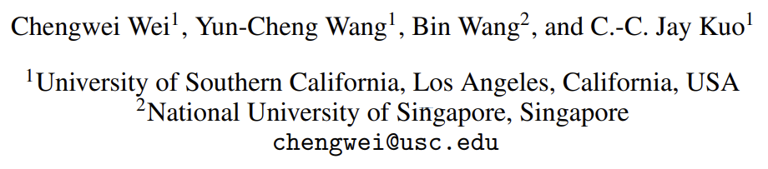
An Overview of Language Models:
Recent developments & Outlook
Sung-Jin Choi

Slide 2
Abstract
Language modeling studies the probability distributions over strings of texts.
It is one of the most fundamental tasks in natural language processing (NLP).
It has been widely used in text generation, speech recognition, machine translation, etc.
Conventional languge models (CLMs) aim to predict the probability of inguistic sequences in a causal manner,
while pre-trained language models (PLMs) cover broader concepts and can be used in both causal sequential modeling and fine-tuning for downstream applications.
PLMs have their own training paradigms (usually self-supervied) and serve as foundation models in models in modern NLP systems.
This overview paper provides an intro to both CLMs and PLMs from five aspects, i.e., linguistic units, architectures, training methods, evalution methods, and applications.
Furthermore, we discouss the relationship between CLMs and PLMs and shed light on the future directions of language modleing in the pre-trained era.

Slide 3
Introduction
Language modeling studies the probability distributions over a sequence of linguistic units, such as words. It is one of the most fundamental tasks and long-standing research topics in natural language processing (NLP).
The developed language models (LMs) find applications in many computational linguistic problems such as text generation, machine translation, speech recognition, natural language generation, question-and-answer systems, etc.
There are two major approaches to language modeling:
The statistical approach based on a relatively small corpus set
The data-driven approach based on a significantly larger corpus set.
Conventional language models (CLMs) predict the probability of linguistic sequences in a casual manner.
They can be learned by both laguage modeling approaches.
The data-drivedn approach has become mainstream nowadays. It exploits a large number of corpora to train neural-network models, leading to pre-trained language models (PLMs). PLMs are then fine-turned with task-specific datasets and objectives for downstream applications.

Slide 4


Conventional Language Models (CLMs)
The goal of CLMs is to model the probability distributions over sequences of lingusitic units:
(1)
where u_{i} can be ethier a charcter, a word, a phrase, or othe linguistic units.
CLMs attempts to predict the next linguistic unit in a text sequence given its preceding contexts:
CLMs are also called auto-regressive language models since the units are predicted in a causal way.
Estimating the probability of a text sequence as shwon in Eq. (1) directly encounters that data sparsity problem.
CLMs often estimate the joint probability of the text sequence by decomposing a text sequence into smaller units.
For example, CLMs leverage the chain rule and the conditional probability to estimate the joint probability in the form of
(2)
(3)

Slide 5

Pre-trained Language Model (PLM)
Training Mehodology
With the development of deep learning, PLMs with neural network structures are pre-trained by collections of massive unlabeled corpora to learn generic knowledge which is then transferred to downstream tasks by task-specific fine-tuning.
Causality Constraint
PLMs do not necessarily follow CLMs in predicting linguistic units as shown in Eq. (2).
For example, bidirectional LMs use both preceding and succeeding contexts to predcit the missing linguistic units via probability estimation:
Bidirectional LMs do not follow the causality constraint and the chain rule in Eq. (3), to access the probability of a text sequence, which makes it inherently diffent from CLMs.
Token Representation
Apart from the differences in the training paradigm and probability modeling, PLMs adopts a different representation for basic units called tokens. PLMs represent tokens by embedding them in a high-dimensional continuous space such as word embedding and sentence embeddings. The new representations offer a flexible and powerful tool that enables PLMs to handle a wide range of tasks.

Slide 6
Types of Language Models beyond CLMs.

Slide 7

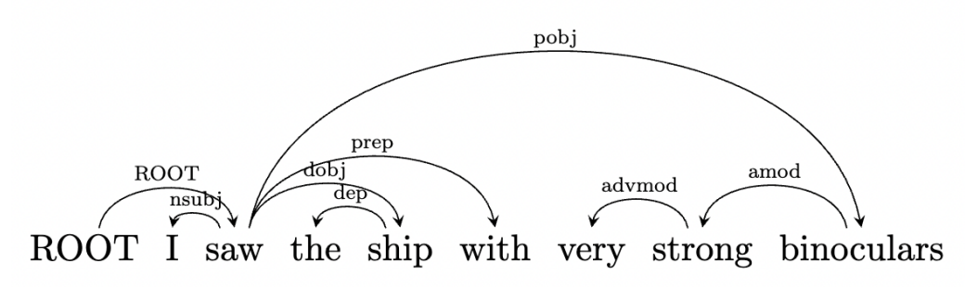
Structural LM
Structural LMs predict linguistic units based on pre-defined linguistic structures such as dependency or constituent parse trees.
Structural LMs utilize the linguistic structure to bring linguistically relevant context closer to the linguistic unit to be predicted.
For example, given a parse tree structure, a structural LM can define the ancestor context A(Ut) of Ut as the sequence from the root node to the parent of Ut.
The example of a dependency parse tree example

Slide 8

Bidirectional LM
Instead of using the causal contexts to make predictions, bidirectional LMs utilize contexts from both directions as shown in Eq. (4).
The masked LM is one representative bidirectional LM. It masks out linguistic units in a text sequence and then, encodes their preceding and succeeding contexts to predict the masked linguistic units. Formally, the prediction can be defined as the estimation of the following conditional probability
where Um is the masked linguistic unit and S¯ is the corrupted text sequence by replacing a certain number of linguistic units with [MASK} symbols.
The goal of bidirectional LMs is to learn the inner dependency between linguistic units in an unsupervised manner.
The trained model can inherit semantics meanings from large-scale unlabeled corpora.
Different from CLMs that aim to model the generation probability of next sequences, pre-trained bidirectional LMs are used as the backbone that transfers the learned knowledge through further fine-tuning in various downstream applications.

Slide 9

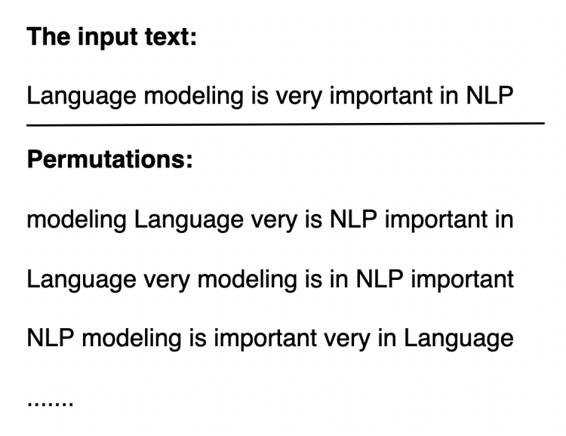
Permutation LM
The permutation LM is a recently proposed LM that takes advantage of CLMs and masked LMs.
Given an input sequence of linguistic units, premutation LMs randomize the order of input linguistic units and construct different permutations of the input sequence.
Figure below shows an example of different permutations given an input text sequence.
Let Z be the set of all possible permutations. Permutation LMs predict the next linguistic unit, Ut, in one permution, Z, of the sequence based on
s
The use of different permutations in a natural sentence

Slide 10
Linguistic Units
To estimate the probability of text seqeucnes, LMs partition text sequences into small linguistic units such as characters, words, phrases, or sentences. This process is called tokenization. The resulting linguistic units are called tokens. Different languages and models may have different appropriate tokenization methods.

Slide 11
Characters
LMs can model text sequences probability based on characters.
As compared with other linguistics units, using characters has a much smaller vocabulary size, leading to a smaller discrete space and model size.
On the othe hand, it is chalenging to predict the next character. Usually, it requires a long historical context. This makes the performance of character-level LMs poorer than that of word-level LMs.
In addition, the input and output lengths have to be longer to model the character distribution accuartely. This results in higher computational costs, especially for auto-regressive decoding.

Slide 12
Words and Subwords
The most natural tokenization for English is to decompose a text sequence into words by white spaces. Many LMs apply word tokenization.
However, there are several issues of native word tokenization.
The first one is the Out-Of-Vocabulary (OOV) problem. Because an LM has a pre-defined vocabulary size that cannot be arbitrartily large, less frequent words and words with character-level errors may not be stored in the pre-defined vocabulary. Thus, they cannot be retrieved from the dictionary.
Although one can extend the vocabulary size to alleviate this problem, it will increase the model size and still cannot handle all possible words.
Recently, researchers are in favor of decomposing words into subwords if they do not appear in the dictionary. This offers a flexible and effective solution to the OOV problem.

Slide 13
Architecture of Language Models

Slide 14
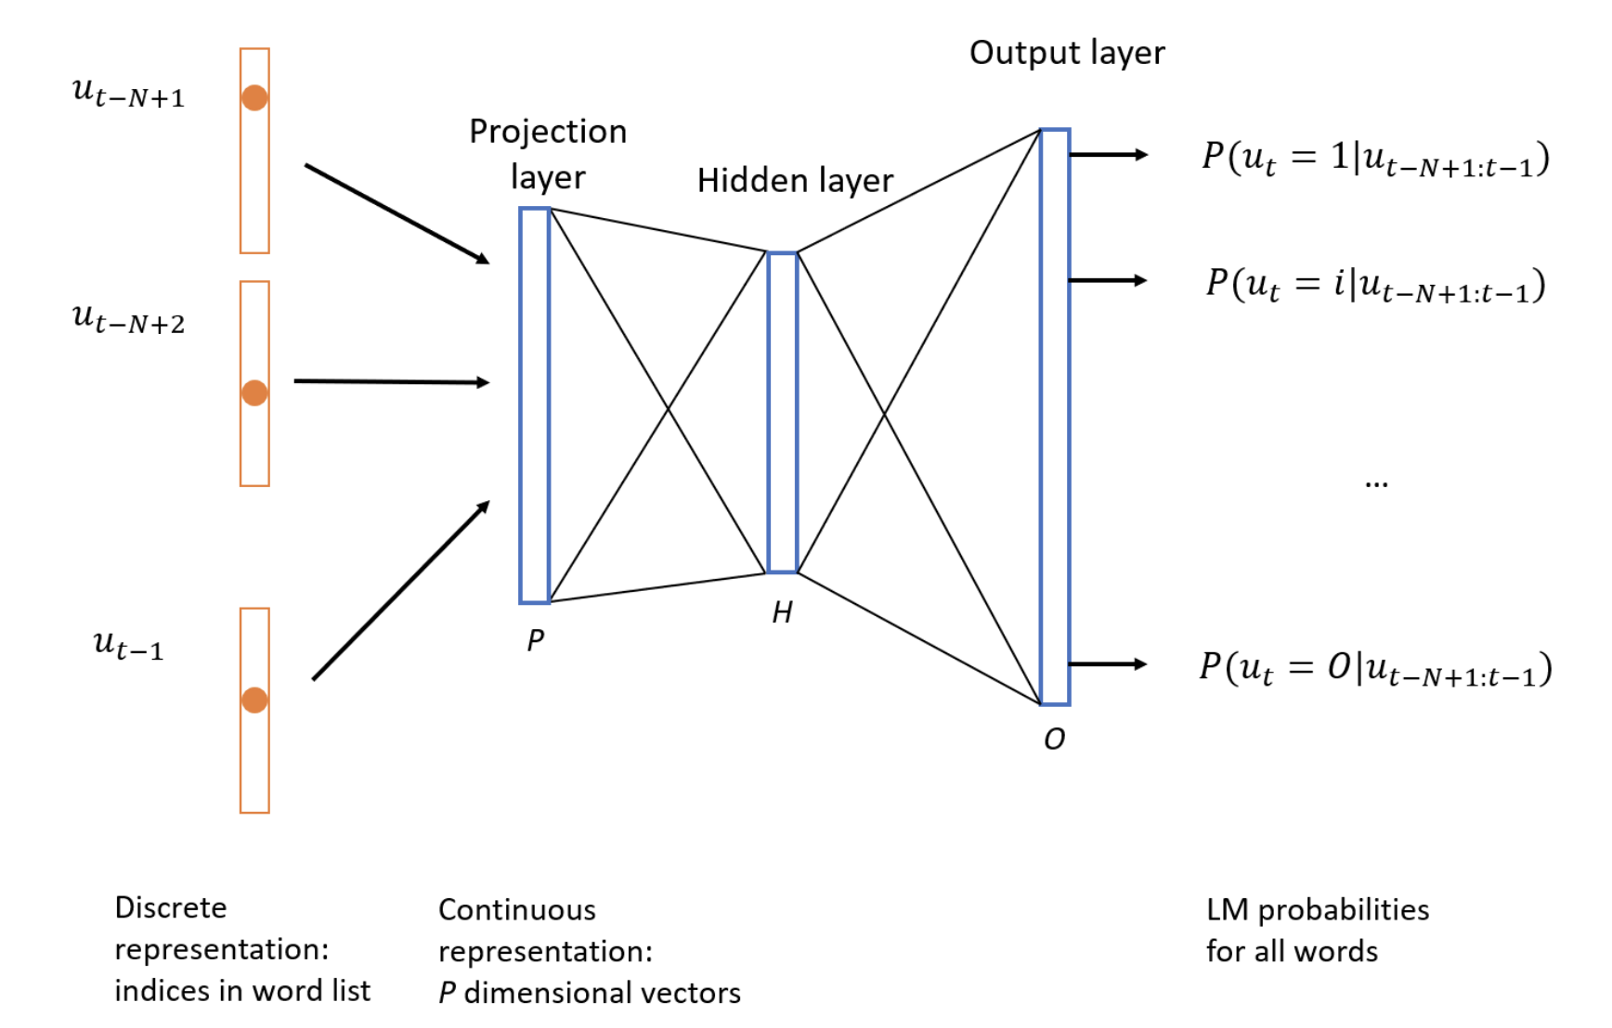
Feed-forward Neural Network (FNN) Models
Feed-forward Neural Network (FNN) LMs is one of the earlier neural network models.
An FNN LM takes historical contexts as the input, and outputs the probability distribution of tokens.
Each token in the preceding context is represented as a vector through a projection layer (i.e., an embedding matrrix).
These vectors of tokens are sent to the hidden layer with H hidden units followed by non-linear activation.
Then, a softmax function is used to obtain the posterior probabilities for token candidates.

Slide 15

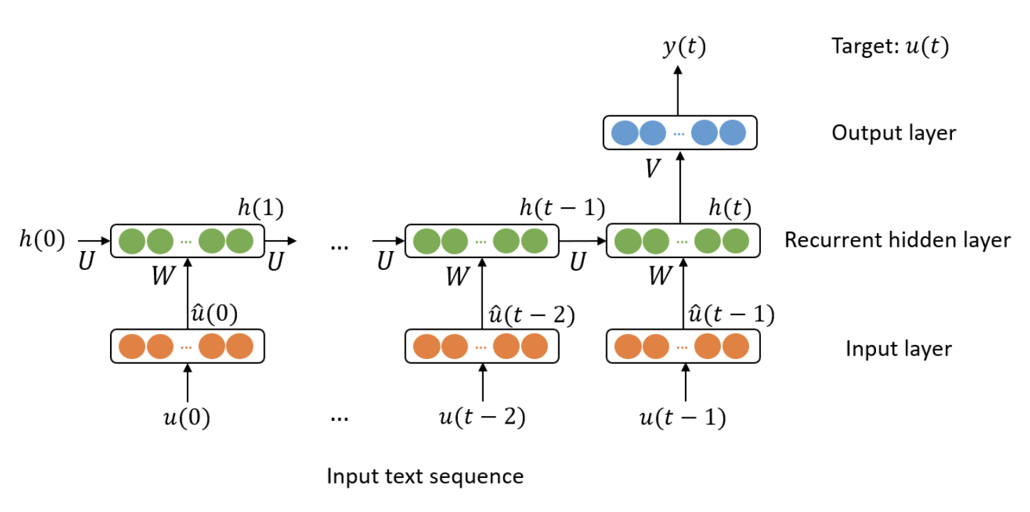
Recurrent Neural Network (RNN) Models
Recurrent Neural Network (RNN) LMs can exploit arbitrarily long histories to predict the next token.
A token u(I) in position I is first converted into a one-hot representation u^(i). Then, the recurrent hidden state, h(i+1), is computed using the previous hidden state, h(i), and the one-hot representation, u^(i), of token u(i) aa

Slide 16
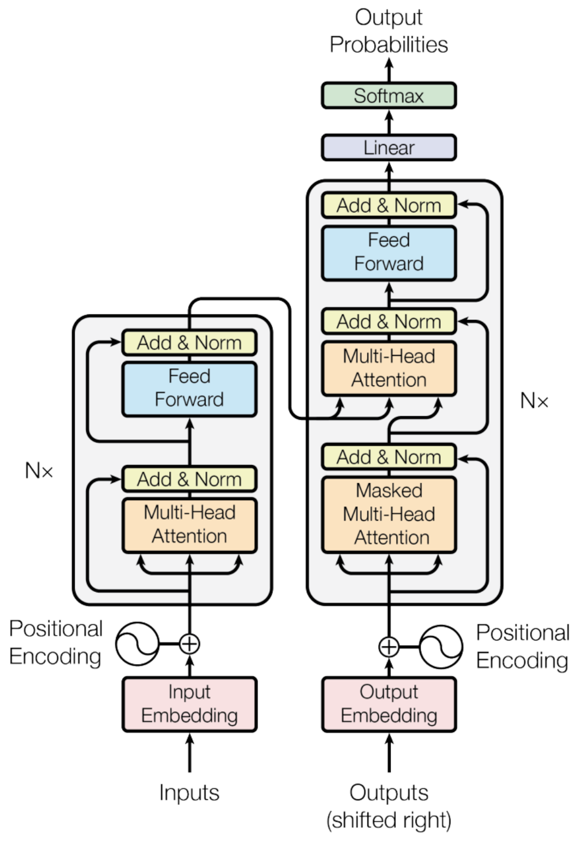
Transformer Architecture
The transformer architecture can capture long-term dependencies and important sequence comonents by exploiting a self-attention mechanism.
Unlike the recurrent strcutrue of RNNs, a transformer is easy to paralleize in both training and inference.
It consists of an encoder and a decoder.
Multi-head attention, which is an ensemble of multiple self-attention mechanisms, enables the transformer to capture more robust and diverse attention between tokens.
The other parts in the transformer encoder include feed-frowrd layers, residual connections, and normalizatioin layers.

Slide 17
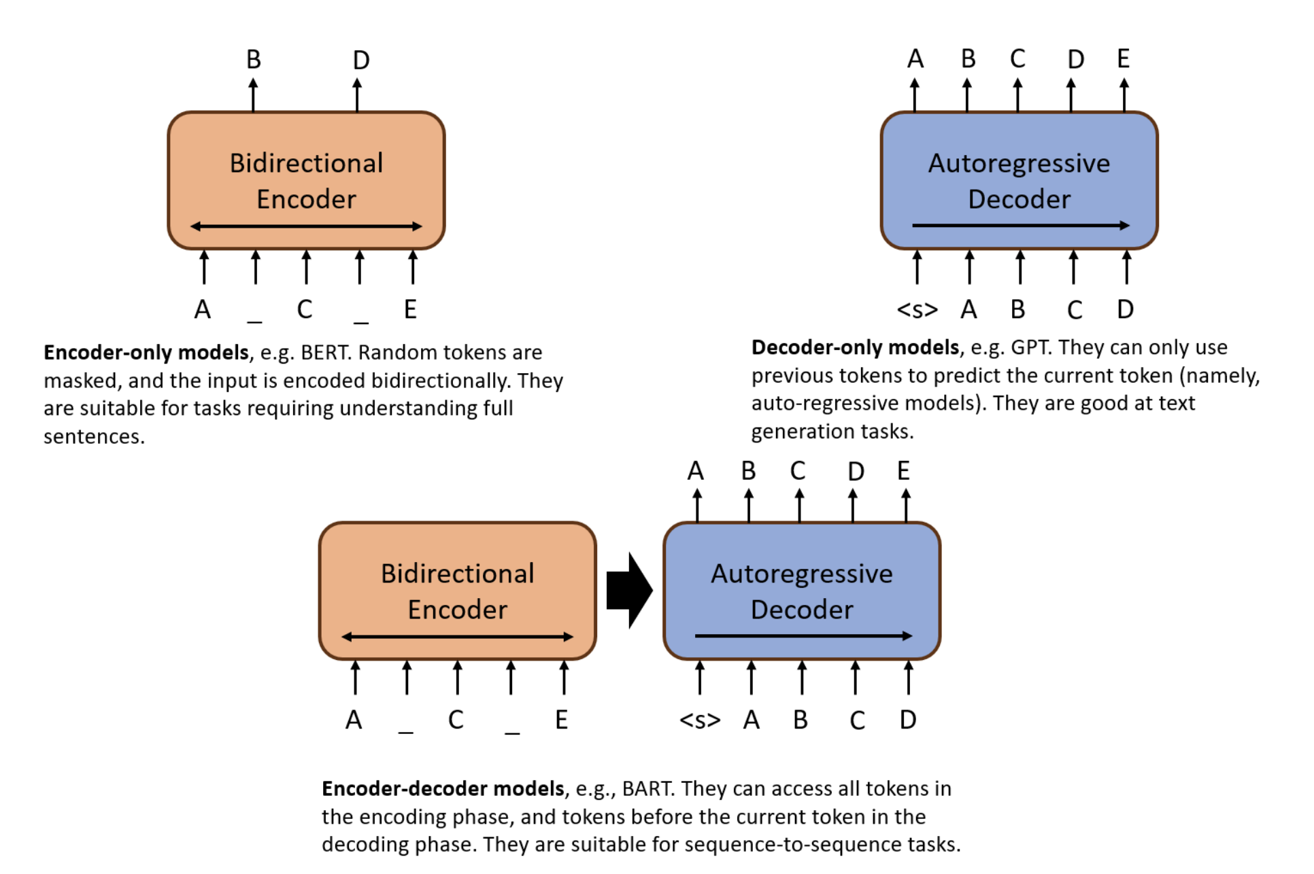
Different Transformer Models
Encoder only modles can access all positions given an input and utilize bi-drectional contexts to predict tokens.
They are sitable for tasks requring understaing full sentences, such as text classification.
Decoder-only models can only use previous tokens to predict the currrent oken (namely, auto-regressive models). They are good at text generation tasks such as story generation.

Slide 18
Fine-Tuning, Adapter Tuning & Prompt Tuning
PLMs learn non-task-specific language knowledge in the pre-training stage.
Fine-tuning performs task-specific adaptations of the model so that they can be applied to differenct downstream tasks.
The model parameters are updated in the fine-tuning stage.
One apprach is to design task-specific heads based on different label spaces and losses in different downstream tasks, then update the entire model and task-specific heads.
For instance, GPT and BERT added an extra linaer output layer as task-specific heads in their original papers, and fine-tuned the entire set of parameters in the PLMs and the heads for various downstream tasks, such as natural language inference, question answering, semantic similarity, and test classificaiton.
Adapter tuning is proposed to make fine-tuning even more parameter efficient compared with updating the last layers of a PLM only.

Slide 19
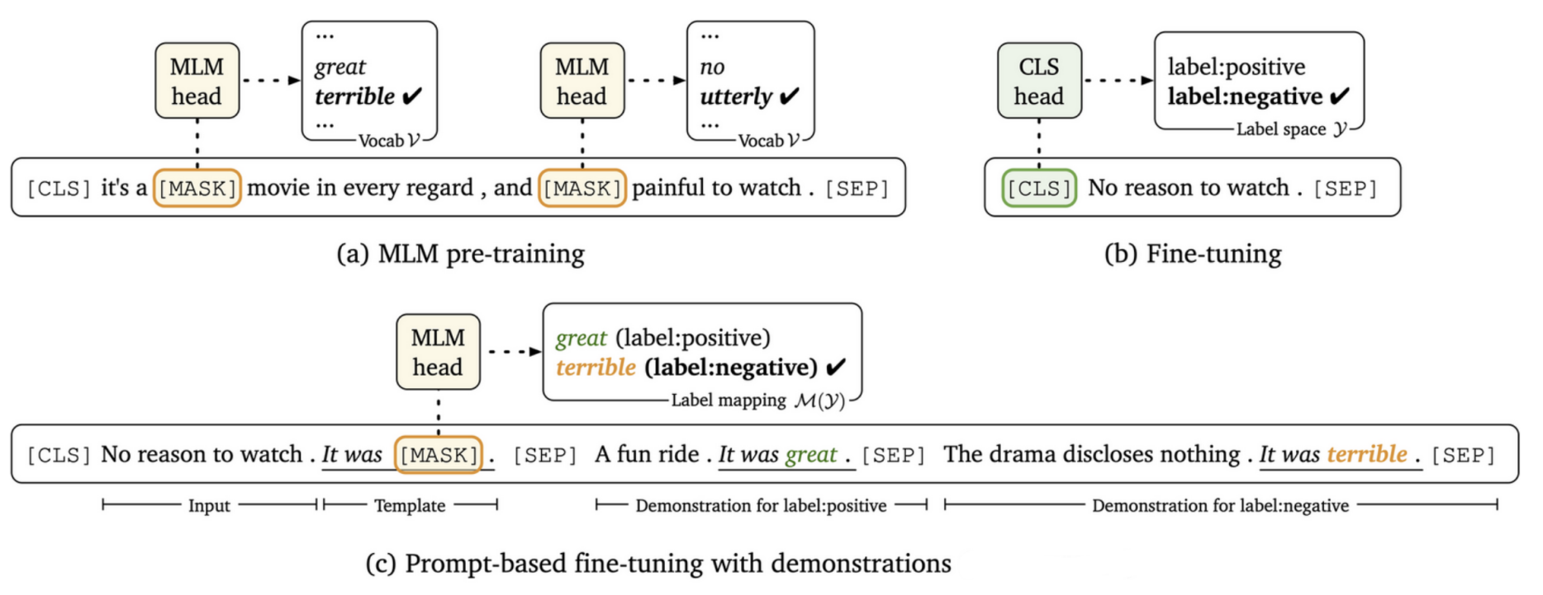
LM Pre-Training, Standard Fine-Tuning & Discrete Prompt-Based Fine-Tuning

Slide 20
Model Evaluation

Slide 21
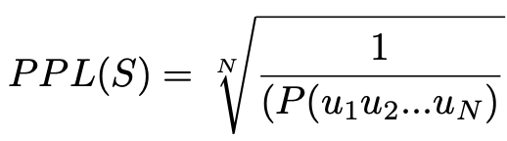
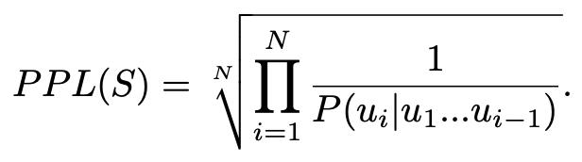
The Perplexity for Evaluation of Auto-Regressvie LM
LMs estimate the probability of text seqeucnes. A good LM assigns higher probabilities to natural text seqeunces and lower ones to unreal or random text seqeucnes.
The perplexity is a common evaluation metric for this purpose. Given a testing text seqeunce, the perplexity, denoted by PPL, is defined as the inverse probability of the sequence normalilzed by the number of tokens.
Where S = u1u2...uN is a testing test sequence. The perplexity can be rewritten in form of
A good LM should maximize the text set probability. It si equivalent to minimizing the perplexity. The lower the perplexity, the bletter the LM.

Slide 22
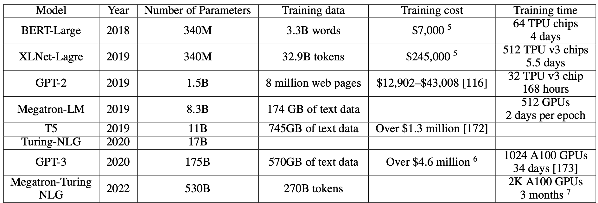

Slide 23
Pre-trained Language Models
Pre-trained language models (PLMs) are dominating in the NLP field nowadays.
The most commonly used pre-traininig task is 'missing token prediction'. There are other pre-training tasks for different purposes, e.g., next-sentence prediction, which allows an LM to learn sentence relationships.

